Slide 1

Angad Beer Singh Dhillon
Pulkit Mathur
Prashant Kumar Modak

Slide 2
About The Data Set
Business
Review
User
Check In
Tip

Slide 3
About The Data Set
Number of reviews: 5996996
Number of Businesses: 188593
Number of Users: 1518169
Number of Tips: 1185348

Slide 4
About Neo 4J
Graph Database
Nodes contain data
Nodes have Edges to Other Nodes
Edges can have properties
Define unique properties to avoid duplicates

Slide 5
Queries and Data Visualization

Slide 6
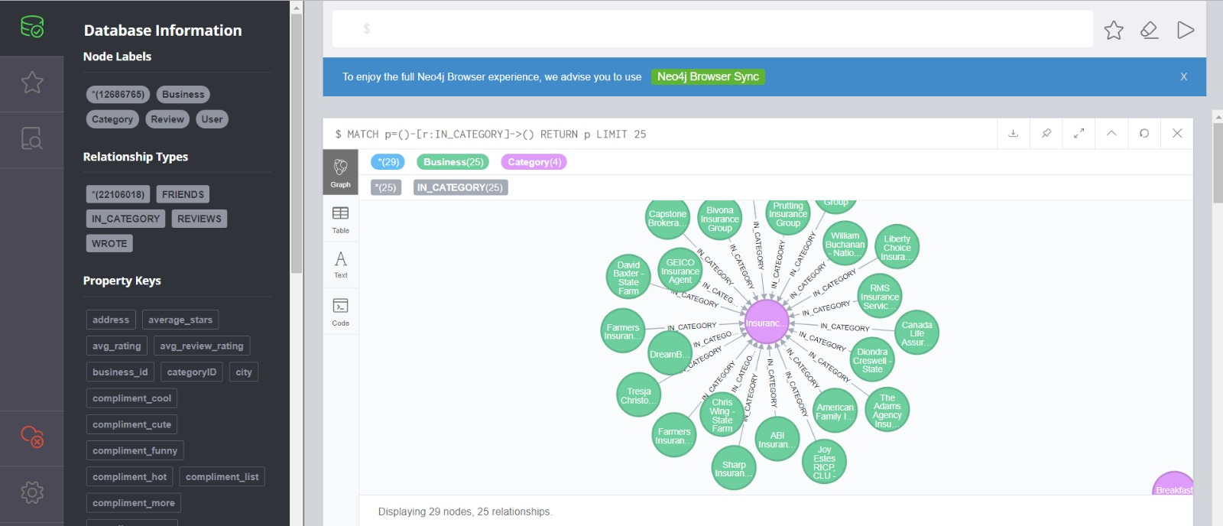
Nodes that have an edge “IN_Category”

Slide 7
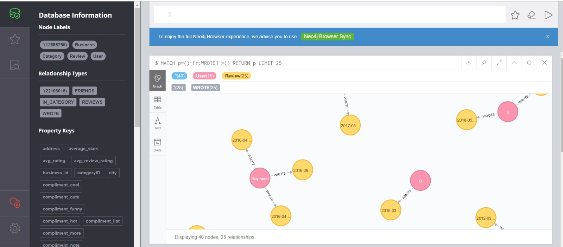
Nodes That have a “Wrote” edge

Slide 8
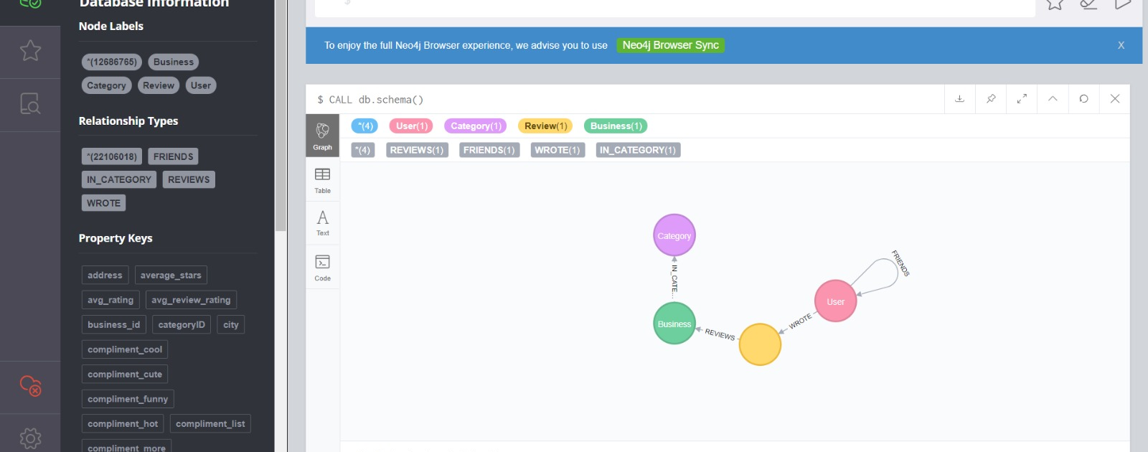
Automatic Schema

Slide 9
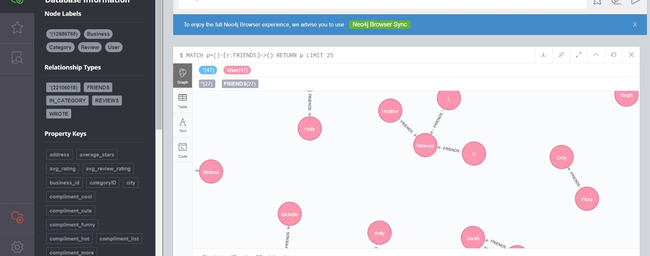
Nodes with Relations “Friends”

Slide 10
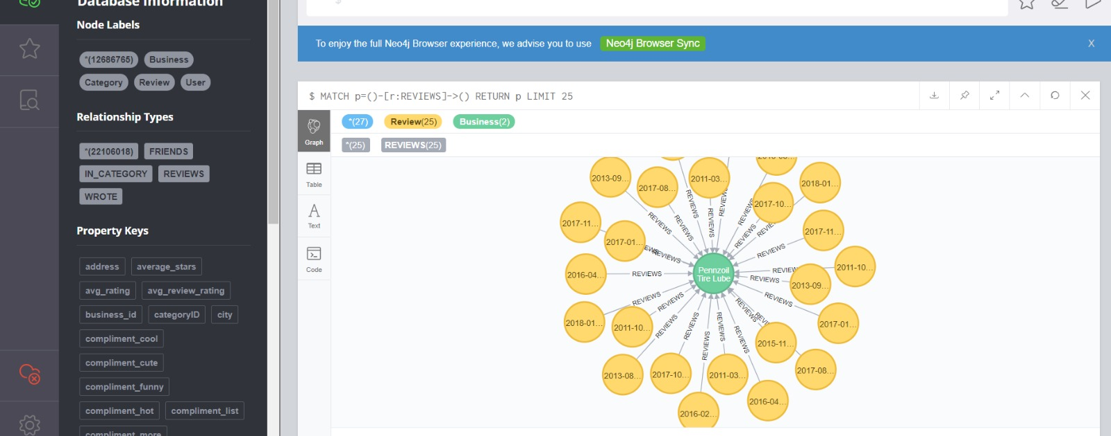
Review Relation to busineses

Slide 11
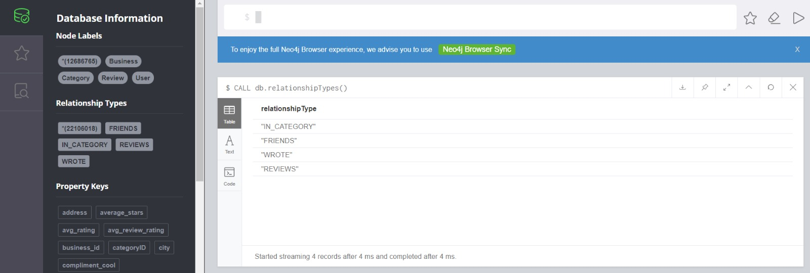
All Relations

Slide 12
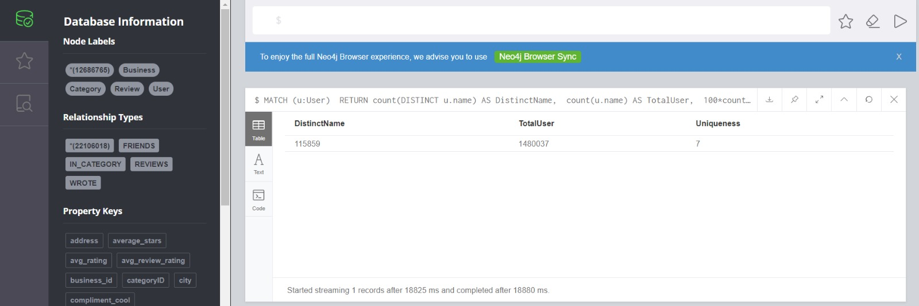

Slide 13
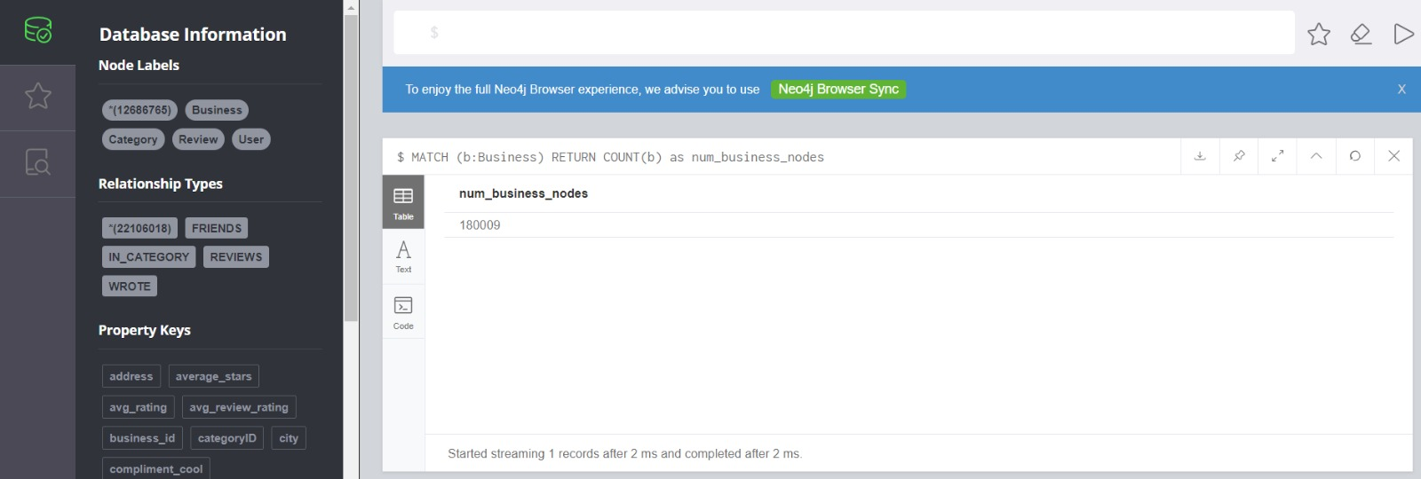
Total Businesses

Slide 14
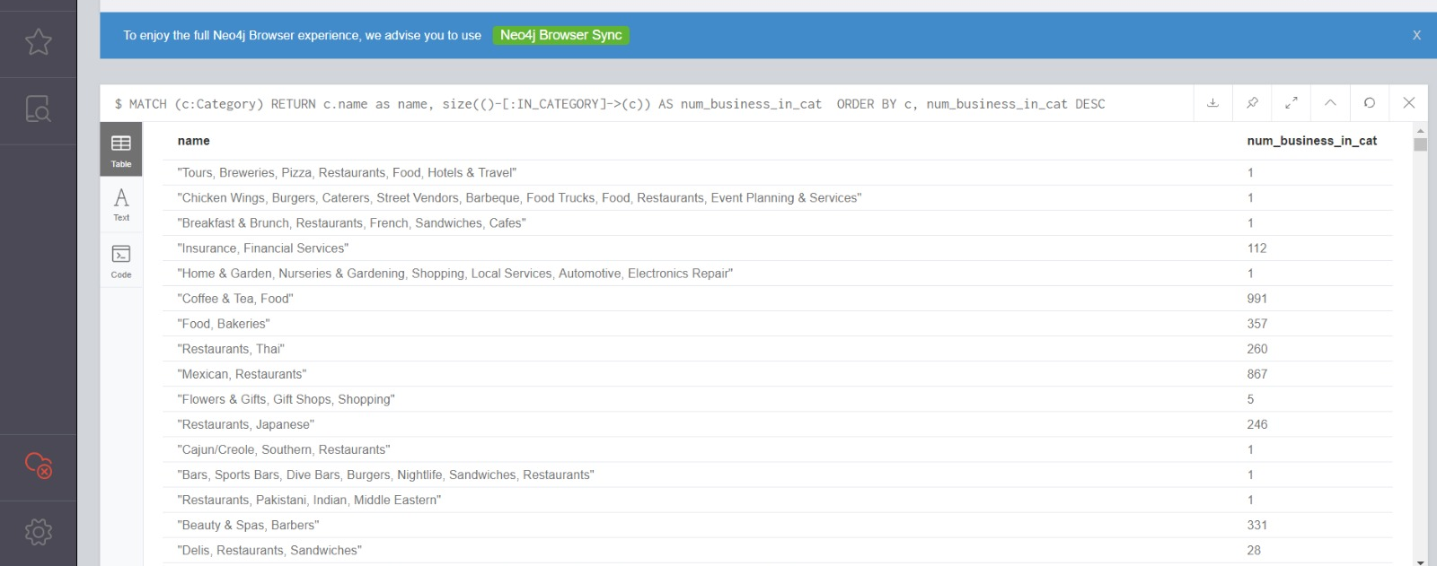
Number of businesses in each category

Slide 15
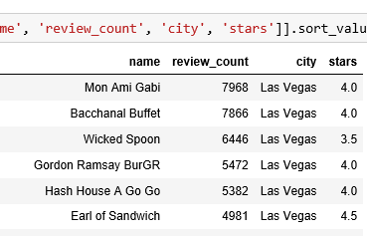
Most Reviewed Businesses

Slide 16
Exploratory Data Analysis

Slide 17
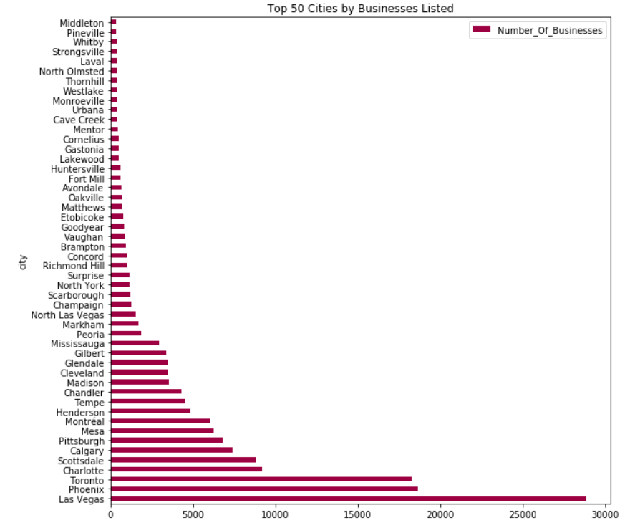

Slide 18
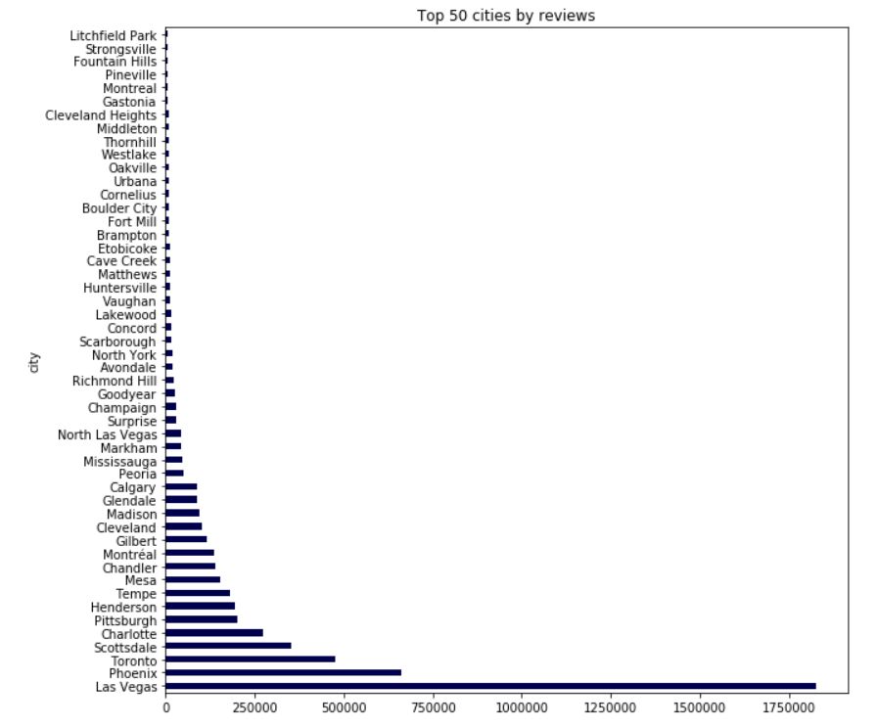

Slide 19
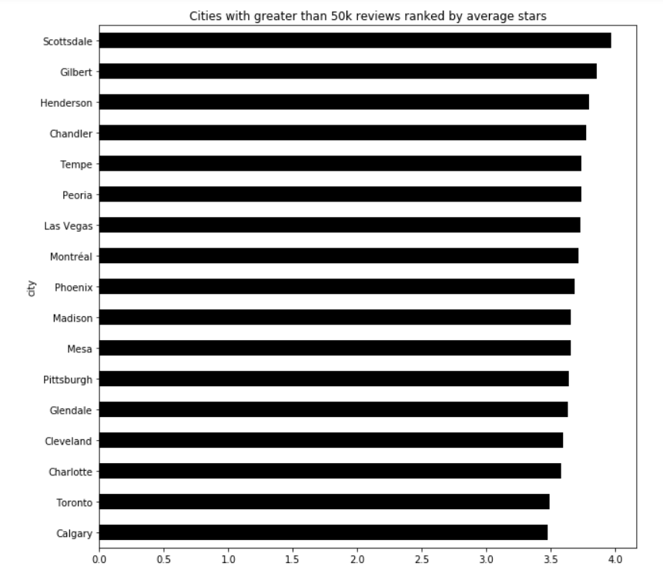

Slide 20
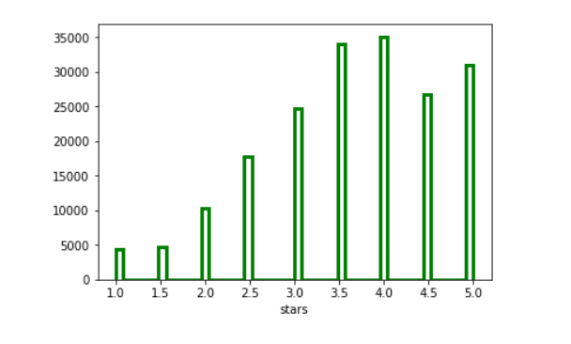

Slide 21
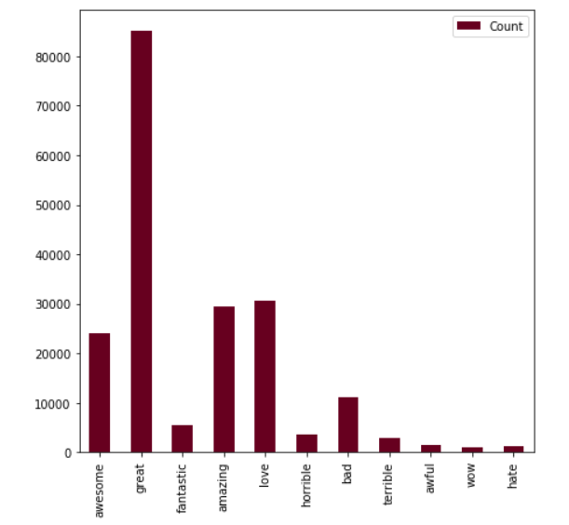

Slide 22
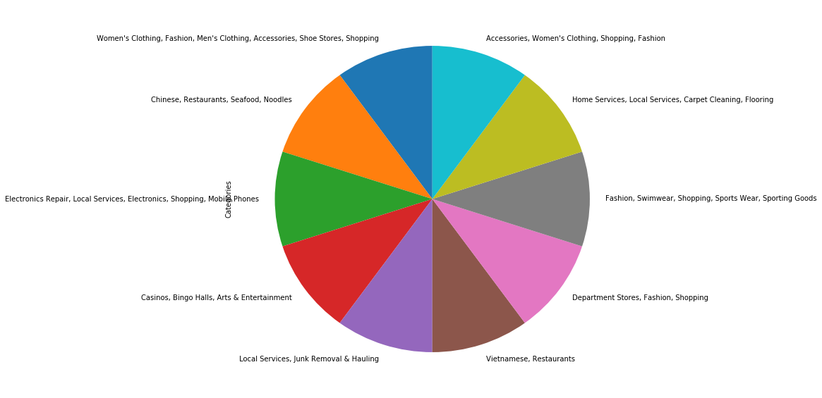

Slide 23
Machine Learning

Slide 24
Restaurant Rating Prediction
Problem: Restaurant rating prediction
Rating range: 1-5
Multi class classification problem
Used business and checkin files
Data Pre-Processing
Combined business and checkin file to create a new file called restaurant
Dropped unnecessary features
Plotted correlation matrix and removed co-related features

Slide 25
Models/Classifiers Developed
Decision Tree Classifier with various maximum depths
Best Test Accuracy: 61.43%
Ensemble Techniques Tried
Ada Boost
Plotted decision boundary and data variation
Support Vector Machines
Linear SVC
SVC with linear kernel
SVC with rbf kernel
Best Test Accuracy: 69.53%
Random Forest
Best Test Accuracy: 61.63%

Slide 26
Models/Classifiers Developed…
Logistic Regression
Test Accuracy: 61.30%
K Nearest Neighbor
K in range 3 to 21
Best Test Accuracy: 69.04
Best k: 19
Naïve Bayes
Bernoulli
Gaussian
Neural Network
3 hidden layers, 100 neurons each, logistic activation function
2 hidden layers, 80 and 160 neurons, tanh activation function
4 hidden layers: 50,100,150,200 neurons respectively and relu activation function
Test Accuracy: 61.58%

Slide 27
THANK YOU

